Slide 1

Allergy and Anaphylaxis
CHAPTER 21

Slide 2
National EMS Education Standard Competencies (1 of 2)
Medicine
Applies fundamental knowledge to provide basic emergency care and transportation based on assessment findings for an acutely ill patient.
Notes:
National EMS Education Standard Competencies
Medicine
Applies fundamental knowledge to provide basic emergency care and transportation based on assessment findings for an acutely ill patient.

Slide 3
National EMS Education Standard Competencies (2 of 2)
Immunology
Recognition and management of shock and difficulty breathing related to
  Anaphylactic reactions
Anatomy, physiology, pathophysiology, assessment, and management of
  Hypersensitivity disorders and/or emergencies
  Anaphylactic reactions
Notes:
National EMS Education Standard Competencies
Immunology
Recognition and management of shock and difficulty breathing related to
• Anaphylactic reactions
Anatomy, physiology, pathophysiology, assessment, and management of
• Hypersensitivity disorders and/or emergencies
• Anaphylactic reactions

Slide 4
Introduction (1 of 2)
EMTs often respond to calls involving allergic reactions.
Allergy-related emergencies may involve:
  Acute airway obstruction
  Cardiovascular collapse
Notes:
Lecture Outline
I. Introduction
A. As an EMT, you will often respond to calls involving an allergic reaction.
1. Allergy-related emergencies may involve:
a. Acute airway obstruction
b. Cardiovascular collapse

Slide 5
Introduction (2 of 2)
You must be able to:
  Treat these life-threatening complications
  Distinguish between the body’s usual response to an allergen and an allergic reaction
Immunology is the study of the body’s immune system.
  Five categories of stimuli that may provoke an allergic reaction.
Notes:
Lecture Outline
2. You must be able to treat these life-threatening complications.
3. You must also be able to distinguish between the body’s usual response to an allergen and an allergic reaction.
B. This chapter describes immunology, which is the study of the body’s immune system, and the five categories of stimuli that may provoke an allergic reaction.

Slide 6
Anatomy and Physiology
The immune system protects the body from foreign substances and organisms.
When a foreign substance invades the body:
  The body initiates a series of responses to inactivate the invader.
Notes:
Lecture Outline
II. Anatomy and Physiology
A. The immune system protects the body from foreign substances and organisms.
B. When a foreign substance invades the body:
1. The body initiates a series of responses to inactivate the invader.

Slide 7
Pathophysiology (1 of 6)
An allergic reaction is an exaggerated immune response to any substance.
Not caused directly by an outside stimulus
Caused by the body’s immune system
  Releases chemicals to combat stimulus
  Includes histamines and leukotrienes
Notes:
Lecture Outline
III. Pathophysiology
A. An allergic reaction is an exaggerated immune response to any substance.
1. It is not caused directly by an outside stimulus, such as a bite or sting.
2. It is caused by the body’s immune system, which releases chemicals to combat the stimulus.
a. These chemicals include histamines and leukotrienes, both of which contribute to an allergic reaction.

Slide 8
Pathophysiology (2 of 6)
Some patients may not know what is causing their reaction, so you must:
  Recognize the signs and symptoms.
  Maintain a high index of suspicion.
An allergic reaction may be mild and local or severe and systemic.
Notes:
Lecture Outline
3. Some patients may not know what is causing their allergic reaction, so you must be able to recognize the signs and symptoms and maintain a high index of suspicion.
4. An allergic reaction may be:
a. Mild and local, characterized by itching, redness, and tenderness
b. Severe and systemic, a condition known as anaphylaxis

Slide 9
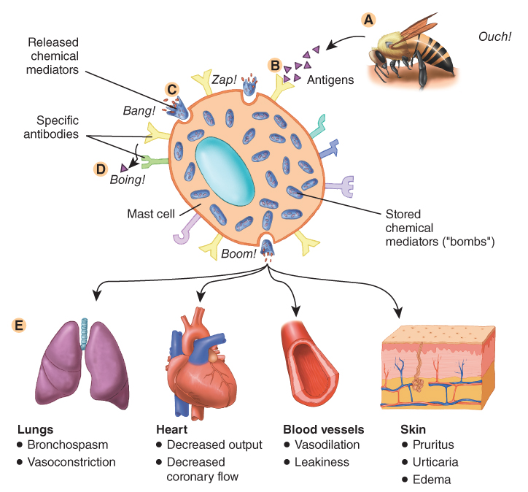
Pathophysiology (3 of 6)
Anaphylaxis is an extreme, life-threatening allergic reaction.
  Involves multiple organ systems
  Can rapidly result in shock and death
FIGURE 21-1 The sequence of events in anaphylaxis. A. The antigen is introduced into the body. B. The antigen–antibody reaction at the surface of a mast cell. C. The release of mast cell chemical mediators. D. Specific antibody reacts with its corresponding antigen. E. Chemical mediators exert their effects on end organs.
© Jones & Bartlett Learning.
Notes:
Lecture Outline
B. Anaphylaxis is an extreme, life-threatening allergic reaction.
1. Involves multiple organ systems
2. In severe cases, it can rapidly result in shock and death.

Slide 10
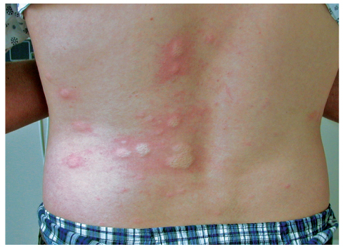
Pathophysiology (4 of 6)
Three common signs of anaphylaxis:
  Urticaria (hives)
    Small areas of generalized itching or burning that appear as multiple, small, raised areas on the skin
FIGURE 21-2 Urticaria, or hives, may appear following
exposure to an allergen and is characterized by multiple
small, raised areas on the skin. Urticaria may be one of the warning signs of an impending anaphylactic reaction.
© Charles Stewart MD, EMDM MPH.
Notes:
Lecture Outline
3. Three common signs:
a. Urticaria (hives)

Slide 11
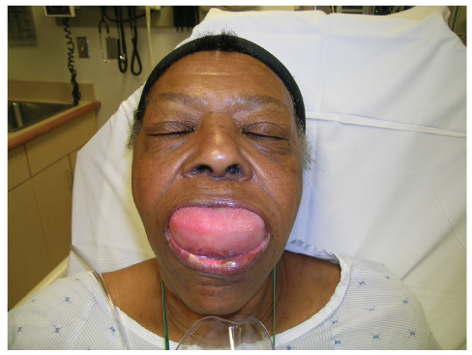
Pathophysiology (5 of 6)
Three common signs of anaphylaxis (cont’d):
  Angioedema
    Areas of localized swelling
  Wheezing
    High-pitched, whistling breath on expiration
FIGURE 21-3 Angioedema is localized swelling associated with allergic reactions. If the site of swelling includes the lips, tongue, larynx, or other such structures, airway obstruction may occur.
© E.M. Singletary, MD. Used with permission.
Notes:
Lecture Outline
b. Angioedema
c. Wheezing

Slide 12
Pathophysiology (6 of 6)
You may also note:
  Stridor on inspiration due to upper airway narrowing
  Hypotension due to vasodilation and increased capillary permeability
  Nausea, vomiting, and abdominal cramps
Notes:
Lecture Outline
4. Stridor may be heard on inspiration if there is upper airway narrowing
5. Hypotension due to vasodilation, as well as increased capillary permeability.
6. Patients may experience, nausea, vomiting, and abdominal cramps)

Slide 13
Common Allergens (1 of 4)
Food
  May take more than 30 minutes to appear
  Shellfish, nuts
Medication
  Antibiotics (eg, penicillin)
  Nonsteroidal anti-inflammatory drugs (NSAIDs)
Notes:
Lecture Outline
IV. Common Allergens
A. The most common allergens fall into one of the following five general categories.
1. Food
a. Certain foods (eg, shellfish, peanuts) may be the most common trigger of anaphylaxis.
b. Symptoms:
i. May take more than 30 minutes to appear
ii. May not include skin signs (eg, hives)
iii. The reaction can be severe and involve the respiratory and/or cardiovascular systems.
2. Medication
a. Medications are the second most common source of anaphylactic reactions, particularly antibiotics (eg, penicillin) and nonsteroidal anti-inflammatory drugs (NSAIDs).

Slide 14
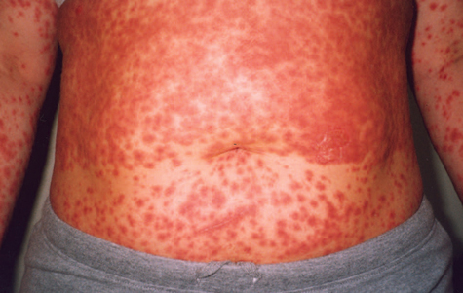
Common Allergens (2 of 4)
Medication (cont’d)
  If medication is injected, the reaction may be immediate and severe.
  Reactions to oral medications may take more than 30 minutes to appear but can also be very severe.
FIGURE 21-4 A severe allergic reaction to medication.
Courtesy of Carol B. Guerrero.
Notes:
Lecture Outline
b. If the medication is injected, the reaction may be immediate (within 30 minutes) and severe.
c. Reactions to oral medications may take more than 30 minutes to appear but can also be very severe.

Slide 15
Common Allergens (3 of 4)
Plants
  Dusts, pollens, and other plant materials
  Ragweed, ryegrass, maple, and oak
Chemicals
  Makeup, soap, and hair dye
  Latex is of particular concern to health care providers
    Nitrile gloves are an alternative.
Notes:
Lecture Outline
3. Plants
a. Dusts, pollens, and other plant materials can cause a rapid and severe allergic reaction.
b. Common plant allergens include ragweed, ryegrass, maple, and oak.
Chemicals
a. Certain chemicals, makeup, soap, hair dye, latex, and various other substances can cause severe allergic reactions.
b. Latex is of particular concern to health care providers.
i. Use latex alternatives such as nitrile gloves.

Slide 16
Common Allergens (4 of 4)
Insect bites and stings
  Envenomation: the process of an insect injecting its venom
  Reaction can be localized or may be severe and systemic.
Notes:
Lecture Outline
5. Insect bites and stings
a. Envenomation: the process of an insect injecting its venom
b. The reaction can be localized or may be severe and systemic.

Slide 17
Insect Stings (1 of 7)
Approximately 2 million Americans are allergic to the venom of bees, wasps, and hornets.
Allergic reactions to insect stings cause at least 62 deaths/year in the United States.
In about half of these deaths, the victim had never experienced a reaction to prior stings.
Notes:
Lecture Outline
B. Insect stings
1. Approximately 2 million Americans are allergic to the venom of bees, wasps, and hornets, and allergic reactions to insect stings account for at least 62 deaths in the United States per year.
2. In about half of these deaths, the victim had never experienced a reaction to prior stings.

Slide 18
Insect Stings (2 of 7)
The stinging organ of most insects is a small hollow spine projecting from the abdomen.
Notes:
Lecture Outline
3. The stinging organ of most insects is a small, hollow spine projecting from the abdomen.

Slide 19
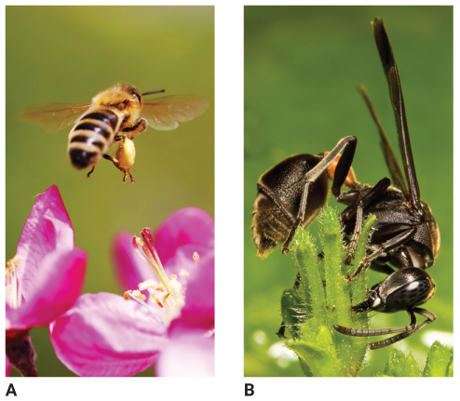
Insect Stings (3 of 7)
Honeybees cannot withdraw their stinger.
Wasps and hornets can sting multiple times.
FIGURE 21-5 Most stinging insects inject venom through
a small, hollow spine that projects from the abdomen.
A. The stinger of the honeybee is barbed; the honeybee
cannot withdraw its stinger once it has stung someone.
B. The wasp’s stinger is unbarbed, meaning that it can
inflict multiple stings.
A: © manfredxy/Shutterstock; B: © Heintje Joseph T. Lee/Shutterstock.
Notes:
Lecture Outline
4. Honeybees cannot withdraw their stinger.
a. If the stinger is not removed, it can continue to inject venom for up to 20 minutes.
5. Wasps and hornets can sting multiple times.

Slide 20
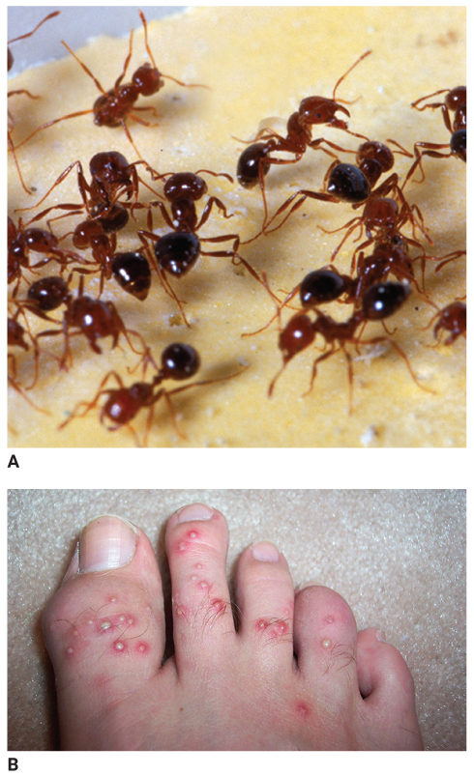
Insect Stings (4 of 7)
Some ants, especially the fire ant, strike repeatedly.
FIGURE 21-6 A. The fire ant. B. Fire ants inject an irritating
toxin at multiple sites. Bites are generally found on the feet
and the legs and appear as multiple small, raised pustules.
A: Courtesy of Scott Bauer/USDA; B: © Scott Camazine/Alamy Stock Photo.
Notes:
Lecture Outline
6. Some ants, especially the fire ant, strike repeatedly.

Slide 21
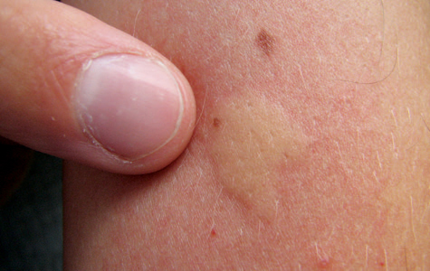
Insect Stings (5 of 7)
Signs and symptoms:
  Sudden pain
  Swelling
  Localized heat
  Urticaria
  Redness in light-skinned individuals
  Itching and a wheal
FIGURE 21-7 A wheal is a whitish, firm elevation of the skin that occurs after an insect sting or bite
© Simon Krzic/Shutterstock.
Notes:
Lecture Outline
7. Signs and symptoms:
a. Sudden pain
b. Swelling
c. Localized heat
d. Widespread urticaria
e. Redness in light-skinned individuals
f. Itching and possibly a wheal

Slide 22
Insect Stings (6 of 7)
In severe (anaphylactic) cases, patients may experience:
  Stridor
  Bronchospasm and wheezing
  Chest tightness and coughing
  Dyspnea
  Anxiety
  Gastrointestinal complaints
  Hypotension
Notes:
Lecture Outline
In more severe (anaphylactic) cases, patients may experience:
a. Stridor
b. Bronchospasm and wheezing
c. Chest tightness and coughing
d. Dyspnea
e. Anxiety
f. Gastrointestinal complaints
g. Hypotension

Slide 23
Insect Stings (7 of 7)
Patients may occasionally experience respiratory failure.
If untreated, anaphylactic reaction can proceed rapidly to death.
More than two-thirds of patients who die of anaphylaxis do so within the first 30 minutes.
Notes:
Lecture Outline
h. Occasionally, respiratory failure
i. If untreated, an anaphylactic reaction can proceed rapidly to death.
j. More than two-thirds of patients who die of anaphylaxis do so within the first 30 minutes.

Slide 24
Patient Assessment in an Immunologic Emergency (1 of 2)
Scene size-up
Scene safety
  The patient’s environment or recent activity may indicate the source of the reaction.
    Sting or bite
    Food allergy
    New medication regimen
Notes:
Lecture Outline
V. Patient Assessment in an Immunologic Emergency
A. Scene size-up
1. Scene safety
a. The patient’s environment or recent activity may indicate the source of the allergic reaction.

Slide 25
Patient Assessment in an Immunologic Emergency (2 of 2)
Scene safety (cont’d)
  Be mindful of other potential causes of respiratory distress.
  Traumatic injury may also be present.
  Follow standard precautions, with a minimum of gloves and eye protection.
  Consider the need for additional resources, such as ALS personnel.
Notes:
Lecture Outline
b. A respiratory problem reported by dispatch may be an allergic reaction.
i. Until a field impression of allergic reaction is firmly established, be mindful of other potential causes of respiratory distress.
ii. Traumatic injury may also be present, secondary to the medical emergency.
c. Follow standard precautions, with a minimum of gloves and eye protection.
d. Consider the need for additional resources, such ALS personnel.

Slide 26
Primary Assessment (1 of 7)
Quickly identify and treat any immediate or potential life threats.
Form a general impression.
  May present as respiratory or cardiovascular distress in the form of shock
  Patients often appear very anxious.
  Call for ALS backup if available.
  Look for a medical identification tag.
Notes:
Lecture Outline
B. Primary assessment
1. Quickly identify and treat any immediate or potential life threats.
a. ABCs should be reassessed repeatedly throughout transport.
2. Form a general impression.
a. Allergic reactions may present as a respiratory condition or as cardiovascular distress in the form of shock.
b. If the patient is anxious and in distress, immediately call for ALS backup if available.
c. Look for a medical identification tag if the patient is found unresponsive or is unable to answer questions.

Slide 27
Primary Assessment (2 of 7)
Airway and breathing
  Anaphylaxis can cause rapid swelling of the upper airway.
  You have only a few minutes to assess the airway and provide lifesaving measures.
  Work quickly to determine the severity of the symptoms.
Notes:
Lecture Outline
3. Airway and breathing
a. Anaphylaxis can cause rapid swelling of the upper airway.
b. Not all allergic reactions are anaphylactic reactions.

Slide 28
Primary Assessment (3 of 7)
Airway and breathing (cont’d)
  Quickly assess for:
    Increased work of breathing
    Use of accessory muscles
    Head bobbing
    Tripod positioning
    Nostril flaring
    Abnormal breath sounds
Notes:
Lecture Outline
c. Quickly assess for increased work of breathing, use of accessory muscles, head bobbing, tripod positioning, nostril flaring, and abnormal breath sounds.

Slide 29
Primary Assessment (4 of 7)
Airway and breathing (cont’d)
  Assist the patient into high Fowler position to maximize ventilations.
  If signs of shock, place the patient in supine position.
  Do not hesitate to initiate high-flow oxygen.
  In severe situations, assist using bag-mask device, attached to oxygen.
Notes:
Lecture Outline
d. Assist the patient into a comfortable position, generally in a high Fowler position, to maximize ventilations.
e. If signs of shock emerge, immediately place the patient in the supine position, as tolerated.
f. For a patient in severe respiratory distress, you may have to assist ventilations using a bag-mask device, attached to a high concentration of oxygen.

Slide 30
Primary Assessment (5 of 7)
Circulation
  May present with hypotension
  Palpate for presence and quality of radial pulse.
    Assess for rapid pulse rate; cool, cyanotic, or red, moist skin; delayed capillary refill.
    May indicate hypoperfusion
Notes:
Lecture Outline
4. Circulation
a. Some patients in anaphylaxis may present with signs and symptoms of circulatory distress, such as hypotension.
b. Assess for signs of hypoperfusion.

Slide 31
Primary Assessment (6 of 7)
Treat for shock.
Definitive treatment for anaphylactic shock is epinephrine.
Notes:
Lecture Outline
Treat for shock.
d. The definitive treatment for anaphylactic shock is epinephrine.

Slide 32
Primary Assessment (7 of 7)
Transport decision
  Always provide prompt transport for any patient who may be having an allergic reaction.
  If the patient does not exhibit severe symptoms, consider continuing the assessment; err on the side of emergency transport.
Notes:
Lecture Outline
5. Transport decision
a. If anaphylaxis is suspected, or if a relatively mild allergic reaction appears to be worsening, immediate transport is warranted.
b. If the patient is calm and does not exhibit severe symptoms, consider continuing the assessment, but err on the side of emergency transport.

Slide 33
History Taking (1 of 4)
Investigate:
  Chief complaint
  History of present illness
Identify:
  Associated signs and symptoms
Notes:
Lecture Outline
C. History taking
1. Investigate the chief complaint or history of present illness. Identify signs and symptoms.

Slide 34
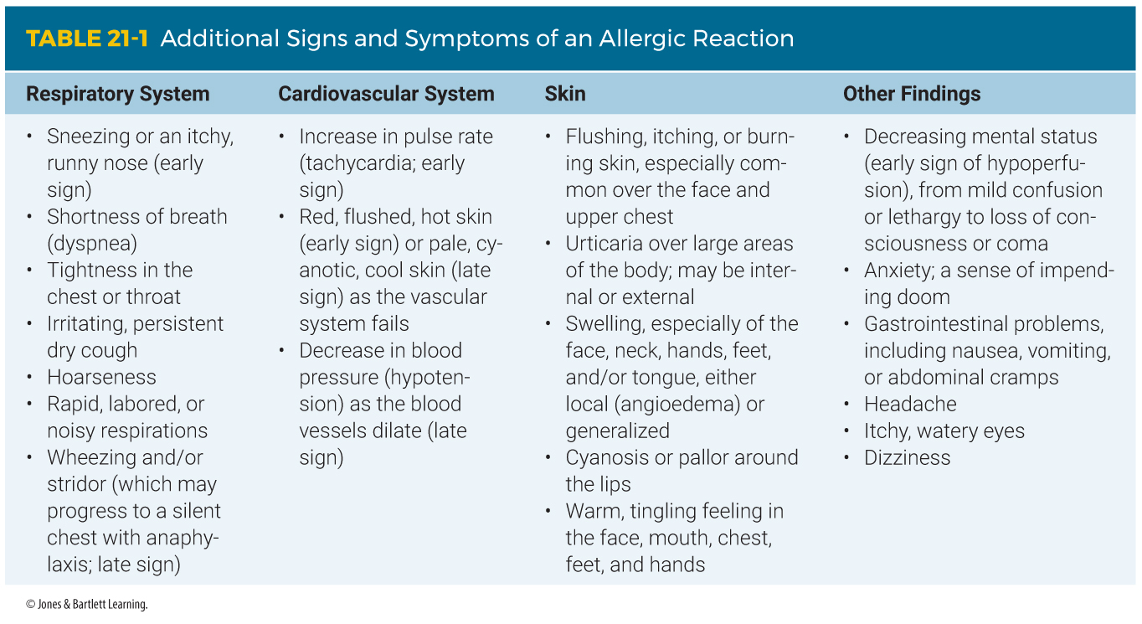
History Taking (2 of 4)
Notes:
The table on this slide shows additional signs and symptoms of an allergic reaction.

Slide 35
History Taking (3 of 4)
SAMPLE history
  If possible, ask the following questions:
    Have any interventions already been completed?
    Has the patient experienced a severe allergic reaction in the past?
Notes:
Lecture Outline
2. SAMPLE history
a. If the patient is responsive, obtain the SAMPLE history (including OPQRST) and ask him or her the following questions specific to an allergic reaction:
i. Have any interventions already been completed?
ii. Has the patient experienced a severe allergic reaction in the past?

Slide 36
History Taking (4 of 4)
Be alert for any statements regarding ingestion of foods that cause allergic reactions.
Ask about gastrointestinal complaints (nausea or vomiting).
Notes:
Lecture Outline
3. Be alert for any statements regarding the ingestion of foods that commonly cause allergic reactions.
4. Inquire about the presence of gastrointestinal complaints such as nausea and vomiting.

Slide 37
Secondary Assessment (1 of 3)
Physical examination
  Systematic head-to-toe or focused assessment
  Auscultate for abnormal breath sounds:
    Wheezing or stridor
  Inspect the skin
    Swelling, rashes, or urticaria
Notes:
Lecture Outline
D. Secondary assessment
1. Physical examination
a. If indicated, perform a rapid exam of the body from head to toe, or conduct a physical examination focused on the area(s) of chief complaint.
b. If the patient is unconscious or otherwise unable to communicate:
i. Remove clothing as necessary and look for the presence of bee stingers, signs of contact with chemicals, and other clues suggestive of a reaction.
ii. Look for a medical alert tag that could indicate a severe allergy.
c. Auscultate for abnormal breath sounds such as wheezing or stridor, and carefully inspect the skin for swelling, rashes, or urticaria.

Slide 38
Secondary Assessment (2 of 3)
Physical examination (cont’d)
  Assess baseline vital signs
    Pulse and respiratory rates
    Blood pressure
    Pupillary response
    Oxygen saturation
  Skin signs may be unreliable.
Notes:
Lecture Outline
2. Vital signs
a. Assess baseline vital signs, including pulse and respiratory rates, blood pressure, pupillary response, and oxygen saturation.
b. Skin signs may be unreliable indicators of hypoperfusion, as they may vary widely or be hidden by rashes and swelling.

Slide 39
Secondary Assessment (3 of 3)
Monitoring devices
  Pulse oximetry can be a useful method to assess the patient’s perfusion status.
  Decision to apply oxygen should be based on:
    Airway patency
    Work of breathing
    Abnormal lung sounds
Notes:
Lecture Outline
3. Monitoring devices
a. Pulse oximetry can be a useful method for assessing the patient’s perfusion status.
b. The decision to apply oxygen should be based on airway patency, work of breathing, and abnormal lung sounds on auscultation, not solely on pulse oximetry readings.

Slide 40
Reassessment (1 of 3)
Repeat the primary assessment, reassess the patient’s vital signs, and repeat the focused physical exam.
  If patient is unstable, reassess every 5 minutes; if stable, every 15 minutes.
  Watch for signs of shock.
Notes:
Lecture Outline
E. Reassessment
1. En route to the hospital, repeat the primary assessment, reassess the patient’s vital signs, and repeat a focused physical examination of the affected body systems.
a. If the patient is unstable, reassess every 5 minutes; if the patient is stable, reassess every 15 minutes.
b. Watch for signs of shock and treat immediately if present.

Slide 41
Reassessment (2 of 3)
Interventions
  Determine the severity of the reaction.
  Mild reactions require supportive care and monitoring.
  Anaphylaxis requires epinephrine and ventilatory support.
  Transport to a medical facility.
  Recheck your interventions.
Notes:
Lecture Outline
2. Interventions
a. Treatment is determined by the severity of the reaction.
i. Mild reactions may require only supportive care and monitoring.
ii. Anaphylaxis requires more aggressive treatment, including epinephrine and ventilatory support.
b. Recheck your interventions.
i. Even if the patient is experiencing relief, transport to the emergency department is still warranted because the medication’s effect will wear off and symptoms will return.

Slide 42
Reassessment (3 of 3)
Communication and documentation
  Documentation should include:
    Signs and symptoms
    Reasons why you chose to provide the care you did
    Patient’s response to the treatment
Notes:
Lecture Outline
3. Communication and documentation
a. Documentation should include:
i. Signs and symptoms found during the assessment
ii. Reasons why you chose to provide the care you did
iii. The patient’s response to the treatment

Slide 43
Emergency Medical Care of
Immunologic Emergencies (1 of 9)
If patient appears to be having a severe allergic (or anaphylactic) reaction:
  Administer BLS.
  Provide prompt transport to the hospital.
Notes:
Lecture Outline
VI. Emergency Medical Care of Immunologic Emergencies
A. If the patient appears to be having a severe allergic (or anaphylactic) reaction:
1. Administer BLS and provide prompt transport to the hospital.

Slide 44
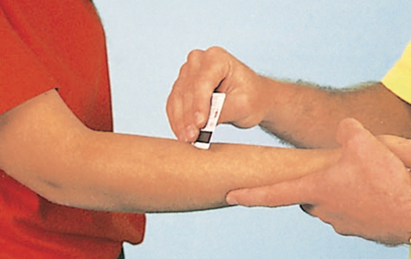
Emergency Medical Care of
Immunologic Emergencies (2 of 9)
If a stinger is present, scrape the skin with the edge of a sharp, stiff object such as a credit card.
Do not use tweezers or forceps.
FIGURE 21-8 To remove the stinger of a honeybee, gently scrape the skin with the edge of a sharp, stiff object such as a credit card.
© Jones & Bartlett Learning.
Notes:
Lecture Outline
2. If a stinger is present, scrape the skin with the edge of a sharp, stiff object such as a credit card (do not use tweezers or forceps).

Slide 45
Emergency Medical Care of
Immunologic Emergencies (3 of 9)
Wash the area with soap or antiseptic.
Remove any jewelry from the area.
Position the injection site below the heart.
Apply ice or cold packs.
Notes:
Lecture Outline
a. Gently wash the area with soap or mild antiseptic.
b. Remove jewelry from the area before swelling begins.
c. Position the injection site slightly below the level of the heart.
d. Apply ice or cold packs to the area, but not directly on the skin and not for more than 10 minutes at a time.

Slide 46
Emergency Medical Care of
Immunologic Emergencies (4 of 9)
Be alert for signs of airway swelling and other signs of anaphylaxis.
Place the patient in supine position, and give oxygen as needed.
Monitor the patient’s vital signs.
Notes:
Lecture Outline
3. Be alert for signs of airway swelling and other signs of anaphylaxis such as nausea, vomiting, and abdominal cramps, and do not give the patient anything by mouth.
4. Place the patient in the supine position as indicated, and give oxygen if needed.
5. Monitor the patient’s vital signs, and be prepared to provide further support as needed.

Slide 47
Emergency Medical Care of
Immunologic Emergencies (5 of 9)
Epinephrine
  Mimics the sympathetic (fight-or-flight) response
  Causes the blood vessels to constrict
  Reverses vasodilation and hypotension
  Increases cardiac contractility and relieves bronchospasm
  Rapidly reverses the effects of anaphylaxis
Notes:
Lecture Outline
B. Epinephrine
1. Epinephrine is a sympathomimetic hormone.
a. It mimics the sympathetic (fight-or-flight) response.
2. Causes the blood vessels to constrict, which reverses vasodilation and hypotension.
3. Other properties of epinephrine increase cardiac contractility and relieve bronchospasm in the lungs.
4. It can rapidly reverse the effects of anaphylaxis.

Slide 48
Emergency Medical Care of
Immunologic Emergencies (6 of 9)
Epinephrine is prescribed by a physician and comes pre-dosed in an epinephrine injector (EpiPen).
Your EMS service may or may not allow you to assist the patient in the administration of epinephrine.
Refer to local protocols or consult medical control.
Notes:
Lecture Outline
5. Epinephrine is prescribed by a physician and comes pre-dosed in an automatic epinephrine injector (EpiPen).
6. Some EMS systems are authorized to carry epinephrine as part of their regular on-board medications; in others, EMS providers may be permitted to help patients self-administer their own medication.
7. Refer to local protocols or consult online medical control.

Slide 49
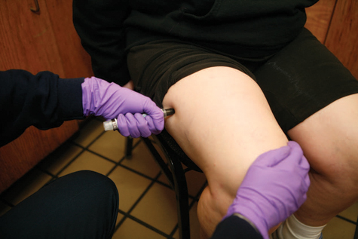
Emergency Medical Care of
Immunologic Emergencies (7 of 9)
All kits should contain a prepared, auto-injectable syringe of epinephrine.
Adult EpiPen delivers 0.3 mg of epinephrine; infant–child system delivers 0.15 mg
FIGURE 21-9 Patients who experience severe allergic reactions often carry their own prescription epinephrine, which comes predosed in an
auto-injector or a prefilled syringe.
© Jones and Bartlett Learning. Courtesy of MIEMSS
Notes:
Lecture Outline
8. The adult EpiPen system delivers 0.3 mg of epinephrine via a spring-loaded needle and syringe system; the infant–child system delivers 0.15 mg.
9. See Skill Drill 21-1 to use an EpiPen auto-injector.
10. Epinephrine can have an effect within 1 minute, so it is the primary way to save the life of someone with a severe anaphylactic reaction.

Slide 50
Emergency Medical Care of
Immunologic Emergencies (8 of 9)
Side effects of epinephrine:
  High blood pressure
  Increased pulse rate
  Anxiety
  Cardiac arrhythmias
  Pallor
  Dizziness
  Chest pain
  Headache
  Nausea
  Vomiting
Notes:
Lecture Outline
Side effects:
a. High blood pressure
b. Increased pulse rate
c. Anxiety
d. Cardiac arrhythmias
e. Pallor
f. Dizziness
g. Chest pain
h. Headache
i. Nausea
j. Vomiting

Slide 51
Emergency Medical Care of
Immunologic Emergencies (9 of 9)
Do not give epinephrine to:
  Patients without signs of respiratory compromise or hypotension
  Those who do not meet the criteria for a diagnosis of anaphylaxis
Notes:
Lecture Outline
12. Patients without signs of respiratory compromise or hypotension and who do not meet the criteria for a diagnosis of anaphylaxis should not be given epinephrine.

Slide 52
Review
The signs and symptoms of an allergic reaction are caused by the release of:
  histamine.
  epinephrine.
  leukotrienes.
  both histamine and leukotrienes.

Slide 53
Review
Answer: D
Response: The two chief chemicals released by the body that result in the signs and symptoms of an allergic reaction are histamines and leukotrienes. Epinephrine (adrenaline) is used to treat allergic reactions. Glucagon is a hormone secreted by the pancreas that helps control metabolism.

Slide 54
Review
The signs and symptoms of an allergic reaction are caused by the release of:
  histamine.
  Rationale: Histamine is a chemical that, along with leukotrienes, is released to cause an allergic reaction.
  epinephrine.
  Rationale: Epinephrine is used to treat anaphylaxis.
  leukotrienes.
  Rationale: Leukotrienes are a chemical that is released, along with histamine, to cause an allergic reaction.
  both histamine and leukotrienes.
  Rationale: Correct answer

Slide 55
Review
The negative effects associated with anaphylactic shock are the result of:
  severe internal fluid loss.
  inadequate pumping of the heart.
  vasodilation and bronchoconstriction.
  the nervous system’s release of adrenaline.

Slide 56
Review
Answer: C
Rationale: Anaphylaxis is an extreme allergic reaction that is life threatening and involves multiple organ systems. In severe cases, anaphylaxis can rapidly result in death. One of the most common signs of anaphylaxis is wheezing, a high-pitched, whistling breath sound that is typically heard on expiration, usually resulting from bronchospasm/bronchoconstriction and increased mucus production.

Slide 57
Review
The negative effects associated with anaphylactic shock are the result of:
  severe internal fluid loss.
  Rationale: The body does not lose fluid; blood pools in the dilated circulatory system and causes less blood flow back to the heart.
  inadequate pumping of the heart.
  Rationale: Inadequate pumping is not the problem; the cardiac output is decreased due to poor return to the heart.
  vasodilation and bronchoconstriction.
  Rationale: Correct answer
  the nervous system’s release of adrenaline.
  Rationale: Adrenaline is the treatment for anaphylaxis.

Slide 58
Review
You are called to a local baseball park for a 23-year-old man with difficulty breathing. He states that he ate a package of peanuts approximately 30 minutes ago and denies any allergies or past medical history. Your assessment reveals widespread urticaria, tachycardia, and a BP of 90/60 mm Hg. You can hear him wheezing, even without a stethoscope. You should be MOST suspicious of a(n):
  acute asthma attack.
  mild allergic reaction.
  anaphylactic reaction.
  moderate allergic reaction.

Slide 59
Review
Answer: C
Rationale: The patient’s signs and symptoms indicate an anaphylactic reaction. Signs and symptoms of an anaphylactic reaction include difficulty breathing, urticaria (hives) over large parts of the body, and signs of shock (eg, tachycardia, hypotension). Certain foods, such as shellfish and nuts, may result in a relatively slow onset of symptoms, but the symptoms can become just as severe.

Slide 60
Review (1 of 2)
You are called to a local baseball park for a 23-year-old man with difficulty breathing. He states that he ate a package of peanuts approximately 30 minutes ago and denies any allergies or past medical history. Your assessment reveals widespread urticaria, tachycardia, and a BP of 90/60 mm Hg. You can hear him wheezing, even without a stethoscope. You should be MOST suspicious of a(n):
  acute asthma attack.
  Rationale: Asthma presents with difficulty breathing, but patients will not have urticaria (hives).
  mild allergic reaction.
  Rationale: Mild reactions usually appear with urticaria, itching, and some swelling, but not hypotension and breathing difficulties.

Slide 61
Review (2 of 2)
You are called to a local baseball park for a 23-year-old man with difficulty breathing. He states that he ate a package of peanuts approximately 30 minutes ago and denies any allergies or past medical history. Your assessment reveals widespread urticaria, tachycardia, and a BP of 90/60 mm Hg. You can hear him wheezing, even without a stethoscope. You should be MOST suspicious of a(n):
  anaphylactic reaction.
  Rationale: Correct answer
  moderate allergic reaction.
  Rationale: The designation is mild or severe reaction (anaphylaxis)—not moderate.

Slide 62
Review
What is a wheal?
  A raised, swollen, well-defined area on the skin
  An area of localized swelling involving the lips, tongue, and larynx
  Generalized itching or burning that appears as multiple, small, raised areas on the skin
  An exaggerated immune response to any substance

Slide 63
Review
Answer: A
Rationale: Insect stings and bites can cause a wheal, which is a raised, swollen, well-defined area on the skin. There is no specific treatment for these injuries, although applying ice sometimes makes them less irritating.

Slide 64
Review
What is a wheal?
  A raised, swollen, well-defined area on the skin
  Rationale: Correct answer
  An area of localized swelling involving the lips, tongue, and larynx
  Rationale: This is the definition of angioedema.
  Generalized itching or burning that appears as multiple, small, raised areas on the skin
  Rationale: This is the definition of urticaria.
  An exaggerated immune response to any substance
  Rationale: This is the definition of an allergic reaction.

Slide 65
Review
You are treating a woman who was stung numerous times by hornets. On assessment, you note that some of the stingers are still embedded in her skin. You should:
  leave the stingers in place.
  scrape the stingers from her skin.
  pull the stingers out with tweezers.
  cover the stings with tight dressings.

Slide 66
Review
Answer: B
Rationale: Because of the venom left in the sac located at the end of the stinger, you should not grab the stingers in an attempt to remove them. Instead, scrape them off with a rigid object such as a credit card.

Slide 67
Review
You are treating a woman who was stung numerous times by hornets. On assessment, you note that some of the stingers are still embedded in her skin. You should:
  leave the stingers in place.
  Rationale: A stinger will continue to inject venom even when the stinger is no longer attached to the insect.
  scrape the stingers from her skin.
  Rationale: Correct answer
  pull the stingers out with tweezers.
  Rationale: Using tweezers may squeeze more venom into the patient.
  cover the stings with tight dressings.
  Rationale: Remove the stingers—do not leave them in place.

Slide 68
Review
A young male is experiencing signs and symptoms of anaphylactic shock after being stung by a scorpion. His level of consciousness is diminished, his breathing is severely labored, you can hear inspiratory stridor, and his face is cyanotic. The patient has a prescribed epinephrine auto-injector. What should you do first?
  Assist him in administering his epinephrine.
  Apply high-flow oxygen via nonrebreathing mask.
  Provide ventilatory assistance with a bag-mask device.
  Elevate his legs and cover him with a warm blanket.

Slide 69
Review
Answer: C
Rationale: The patient is not breathing adequately, as noted by his decreased level of consciousness, severely labored breathing, inspiratory stridor, and cyanosis. Therefore, you should first assist his ventilations with a bag-mask device. He clearly requires epinephrine, but not before restoring adequate breathing first. Regardless of the situation, a patient’s airway must be patent and his or her breathing must remain adequate at all times.

Slide 70
Review (1 of 2)
A young male is experiencing signs and symptoms of anaphylactic shock after being stung by a scorpion. His level of consciousness is diminished, his breathing is severely labored, you can hear inspiratory stridor, and his face is cyanotic. The patient has a prescribed epinephrine auto-injector. What should you do first?
  Assist him in administering his epinephrine.
  Rationale: This is part of the treatment, but only after his breathing has been addressed.
  Apply high-flow oxygen via nonrebreathing mask.
  Rationale: Respirations need assistance due to labored breathing and a diminished level of consciousness.

Slide 71
Review (2 of 2)
A young male is experiencing signs and symptoms of anaphylactic shock after being stung by a scorpion. His level of consciousness is diminished, his breathing is severely labored, you can hear inspiratory stridor, and his face is cyanotic. The patient has a prescribed epinephrine auto-injector. What should you do first?
  Provide ventilatory assistance with a bag-mask device.
  Rationale: Correct answer
  Elevate his legs and cover him with a warm blanket.
  Rationale: You should treat for shock, but breathing is the first priority.

Slide 72
Review
The MOST reliable indicator of upper airway swelling during a severe allergic reaction is:
  stridor.
  anxiety.
  cyanosis.
  wheezing.

Slide 73
Review
Answer: A
Rationale: Stridor is a high-pitched sound that is most often heard during inhalation. It indicates swelling of the upper airway. Wheezing, a whistling sound, is caused by narrowed bronchioles; it indicates narrowing or swelling of the lower airway. Anxiety and cyanosis can occur from a variety of causes; they are not exclusive to airway swelling.

Slide 74
Review
The MOST reliable indicator of upper airway swelling during a severe allergic reaction is:
  stridor.
  Rationale: Correct answer
  anxiety.
  Rationale: This is typically a symptom of hypoxia or decreased oxygenation to the brain.
  cyanosis.
  Rationale: This is a sign of hypoxia and inadequate tissue perfusion.
  wheezing.
  Rationale: This is a sign of lower airway constriction or narrowing.

Slide 75
Review
The most common trigger of anaphylaxis is:
  plants.
  chemicals.
  medications.
  food.

Slide 76
Review
Answer: D
Rationale: Foods such as shellfish and peanuts are the most common triggers of anaphylaxis. These foods account for 30% of deaths from anaphylaxis, especially in adolescents and young adults.

Slide 77
Review
The most common trigger of anaphylaxis is:
  plants.
  Rationale: Although plants can cause a severe anaphylactic reaction, they are a less common trigger compared to food.
  chemicals.
  Rationale: While several chemicals can cause a severe anaphylactic reaction, they do not lead to as many as food.
  medications.
    Rationale: Medications are the second most common source of anaphylactic
    reactions.
  food.
  Rationale: Correct answer

Slide 78
Review
The adult EpiPen system delivers _____ mg of epinephrine, and the
infant–child system delivers _____ mg.
  0.15, 0.3
  0.3, 0.15
  0.15, 0.5
  0.5, 0.2

Slide 79
Review
Answer: B
Rationale: The adult EpiPen system delivers 0.3 mg of epinephrine via an automatic needle and syringe system; the infant–child system delivers 0.15 mg.

Slide 80
Review
The adult EpiPen system delivers _____ mg of epinephrine, and the
infant–child system delivers _____ mg.
  0.15, 0.3
  Rationale: This is not the correct dosage.
  0.3, 0.15
  Rationale: Correct answer
  0.15, 0.5
  Rationale: This is not the correct dosage.
  0.5, 0.2
  Rationale: This is not the correct dosage.

Slide 81
Review
When administering epinephrine by auto-injector, the EMT should hold the injector in place for:
  5 seconds.
  10 seconds.
  20 seconds.
  30 seconds.

Slide 82
Review
Answer: B
Rationale: When administering epinephrine via auto-injector, push the injector firmly against the thigh until it activates. Hold the injector in place for 10 seconds to ensure that all the medication is injected.

Slide 83
Review
When administering epinephrine by auto-injector, the EMT should hold the injector in place for:
  5 seconds.
  Rationale: The injector should be held in place for 10 seconds.
  10 seconds.
  Rationale: Correct answer
  20 seconds.
  Rationale: The injector should be held in place for 10 seconds.
  30 seconds.
  Rationale: The injector should be held in place for 10 seconds.

